Slide 1

Inception v3

Slide 2

Reference
Chapter 13 (O'Reilly) of Hands-On ML
Hvass Lab’s GitHub and Youtube
Youtube on Retrieving URL
Paper
Youtube
Code

Slide 3
Inception v3 Download

Slide 4
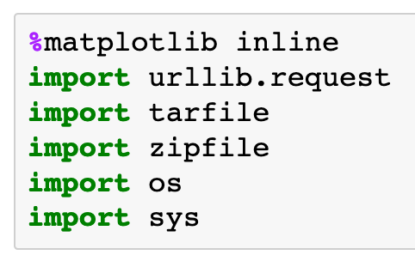

Slide 5
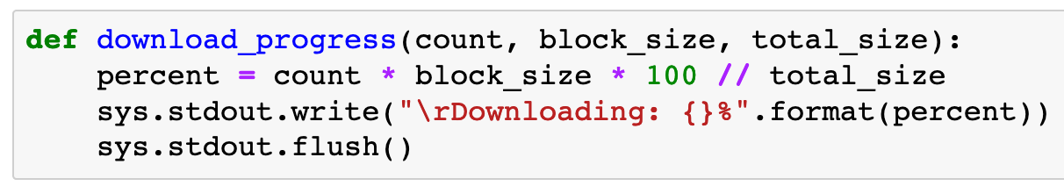

Slide 6
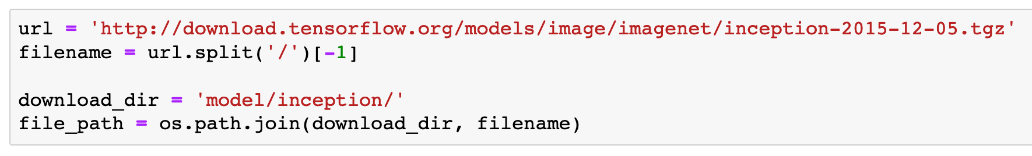

Slide 7
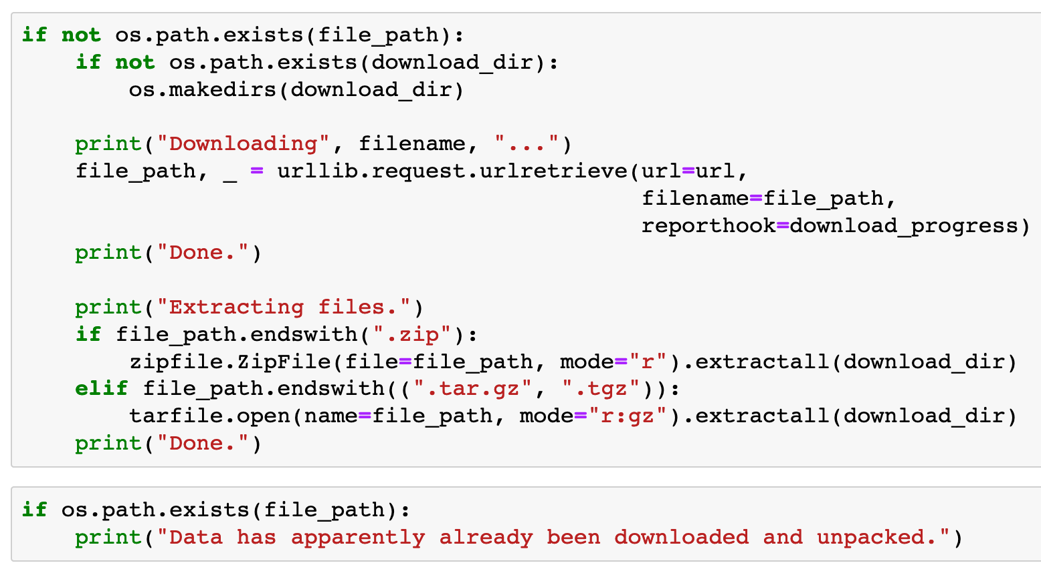

Slide 8
Construct
cls_to_name
Function

Slide 9
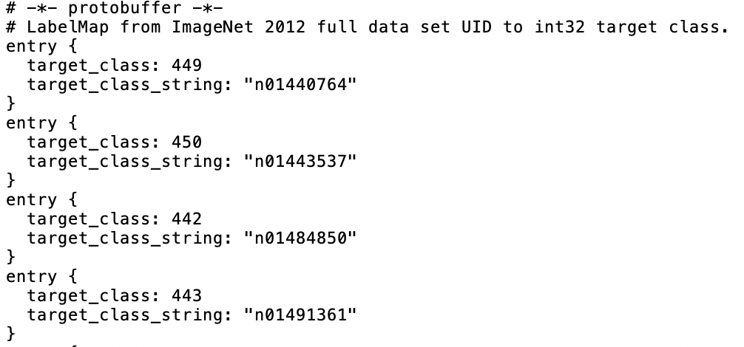
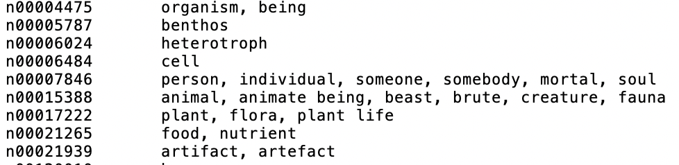
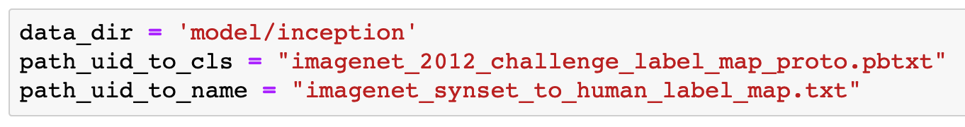
…challenge_label_map.proto.pbtxt
…human_label_map.txt

Slide 10
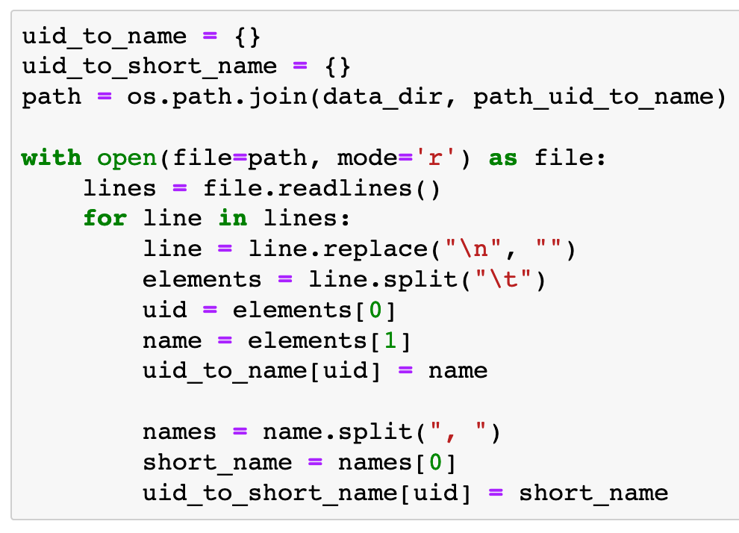
…human_label_map.txt

Slide 11
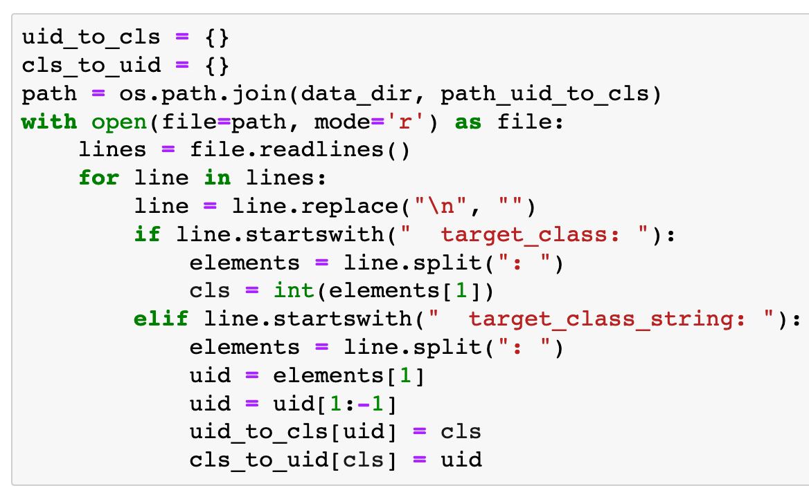
…challenge_label_map.proto.pbtxt

Slide 12
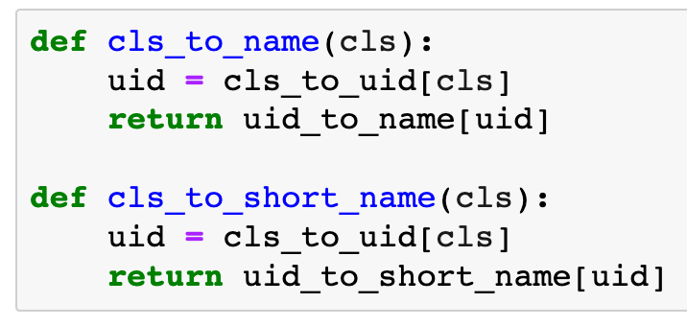

Slide 13
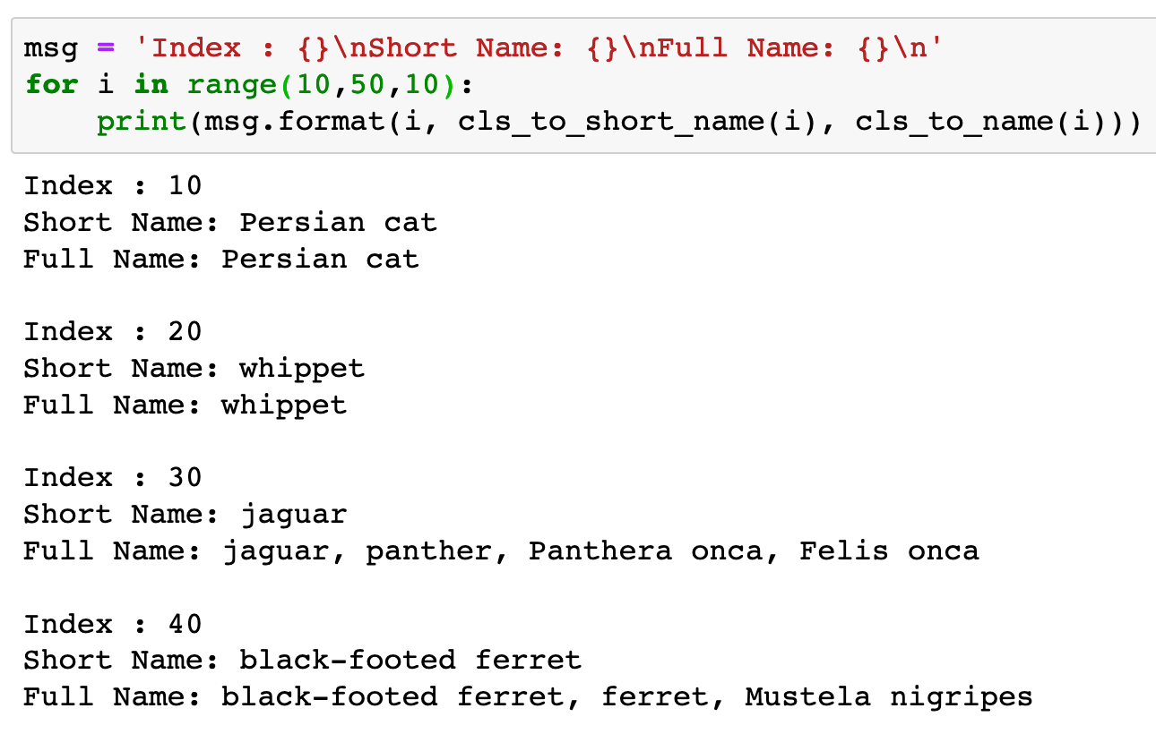

Slide 14
Restore Graph

Slide 15
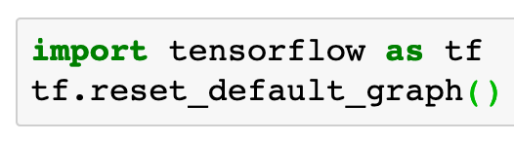

Slide 16
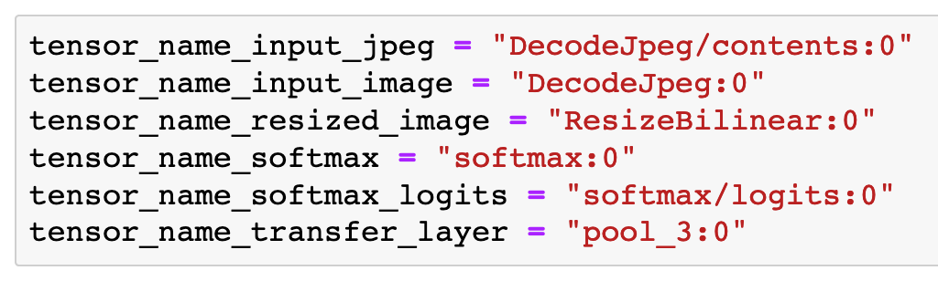

Slide 17
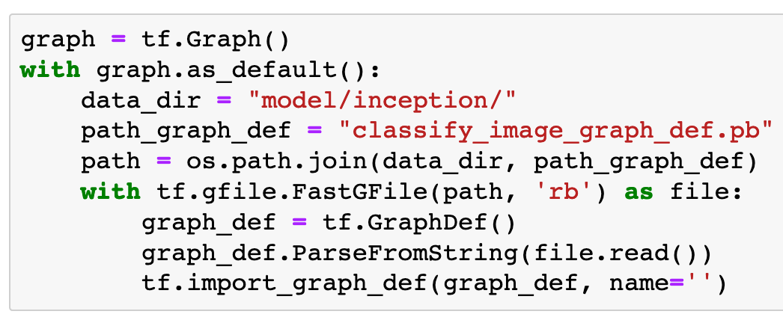

Slide 18
Construct Empty Graph graph

Slide 19
Construct Empty Graph graph
Use graph as default graph
and do the following

Slide 20
Inception v3 graph info file (Downloaded)

Slide 21
Inception v3 graph info file (Downloaded)
read bytes

Slide 22
Inception v3 graph info file (Downloaded)
read bytes
read

Slide 23
parse from string and update graph_def
Inception v3 graph info file (Downloaded)
read bytes
read

Slide 24
Import graph_def to default graph, i.e., graph
parse from string and update graph_def
Inception v3 graph info file (Downloaded)
read bytes
read

Slide 25
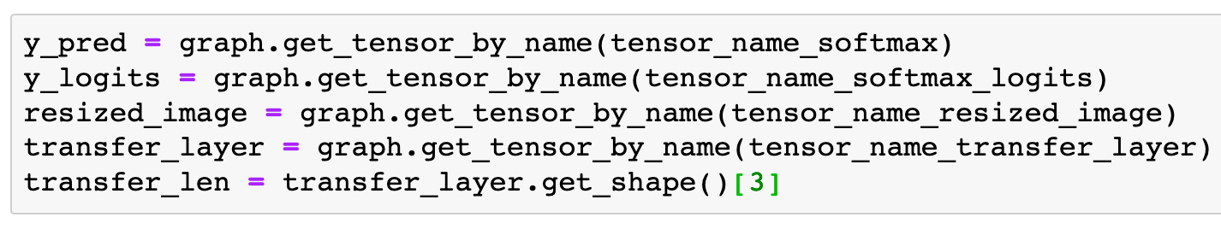

Slide 27
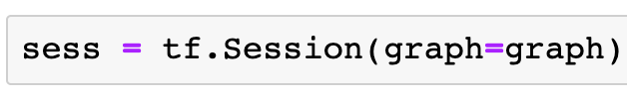

Slide 28
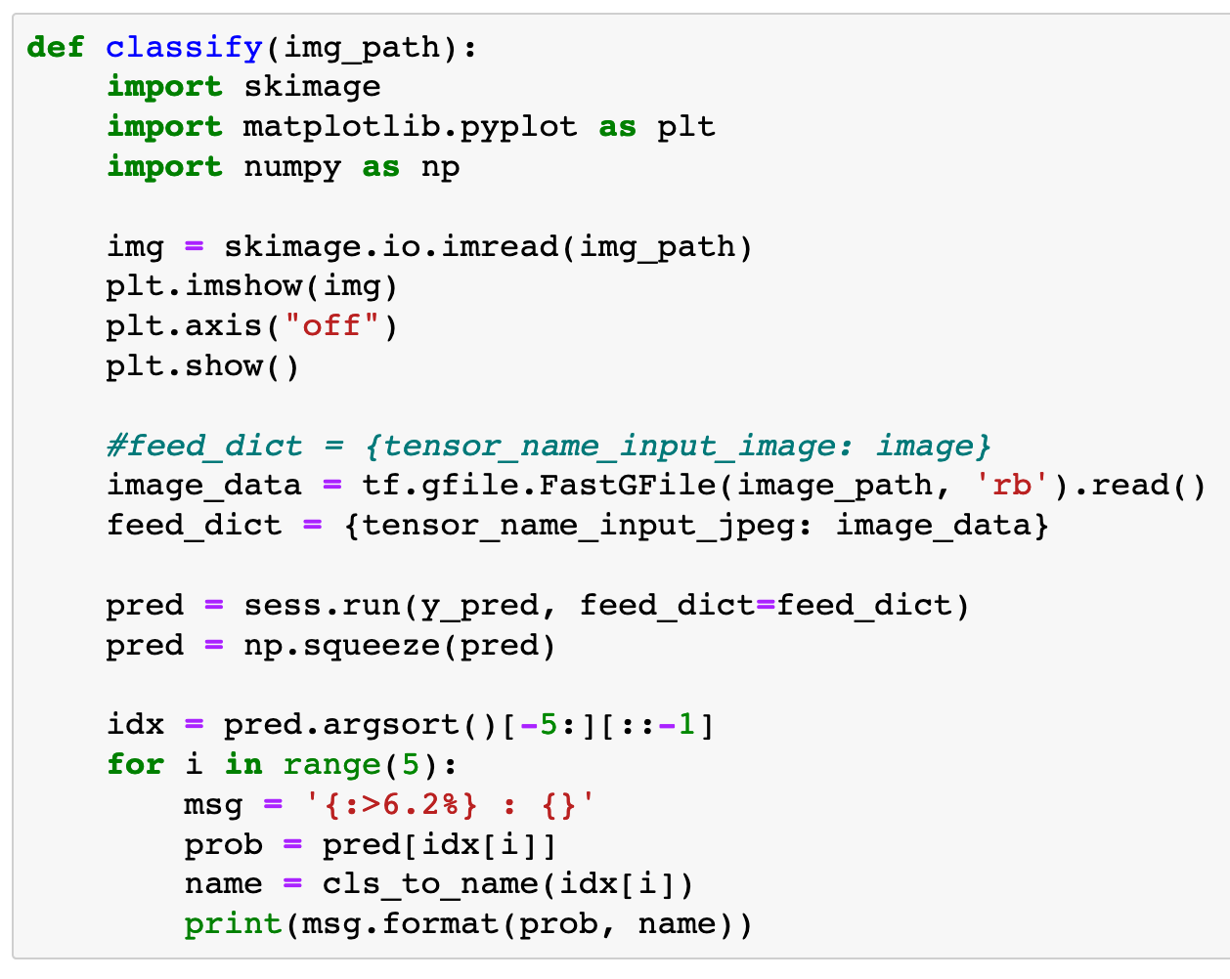

Slide 29
image read

Slide 30
image read
image show

Slide 31
image path

Slide 32
image path
read bytes

Slide 33
image path
read bytes
read

Slide 34
image data
image path
read bytes
read

Slide 35
placeholder for image

Slide 36
placeholder for image
image to feed

Slide 37
argument sort from smallest to largest

Slide 38
argument sort from smallest to largest
pick up last five

Slide 39
argument sort from smallest to largest
pick up last five
change order

Slide 40
Test

Slide 41
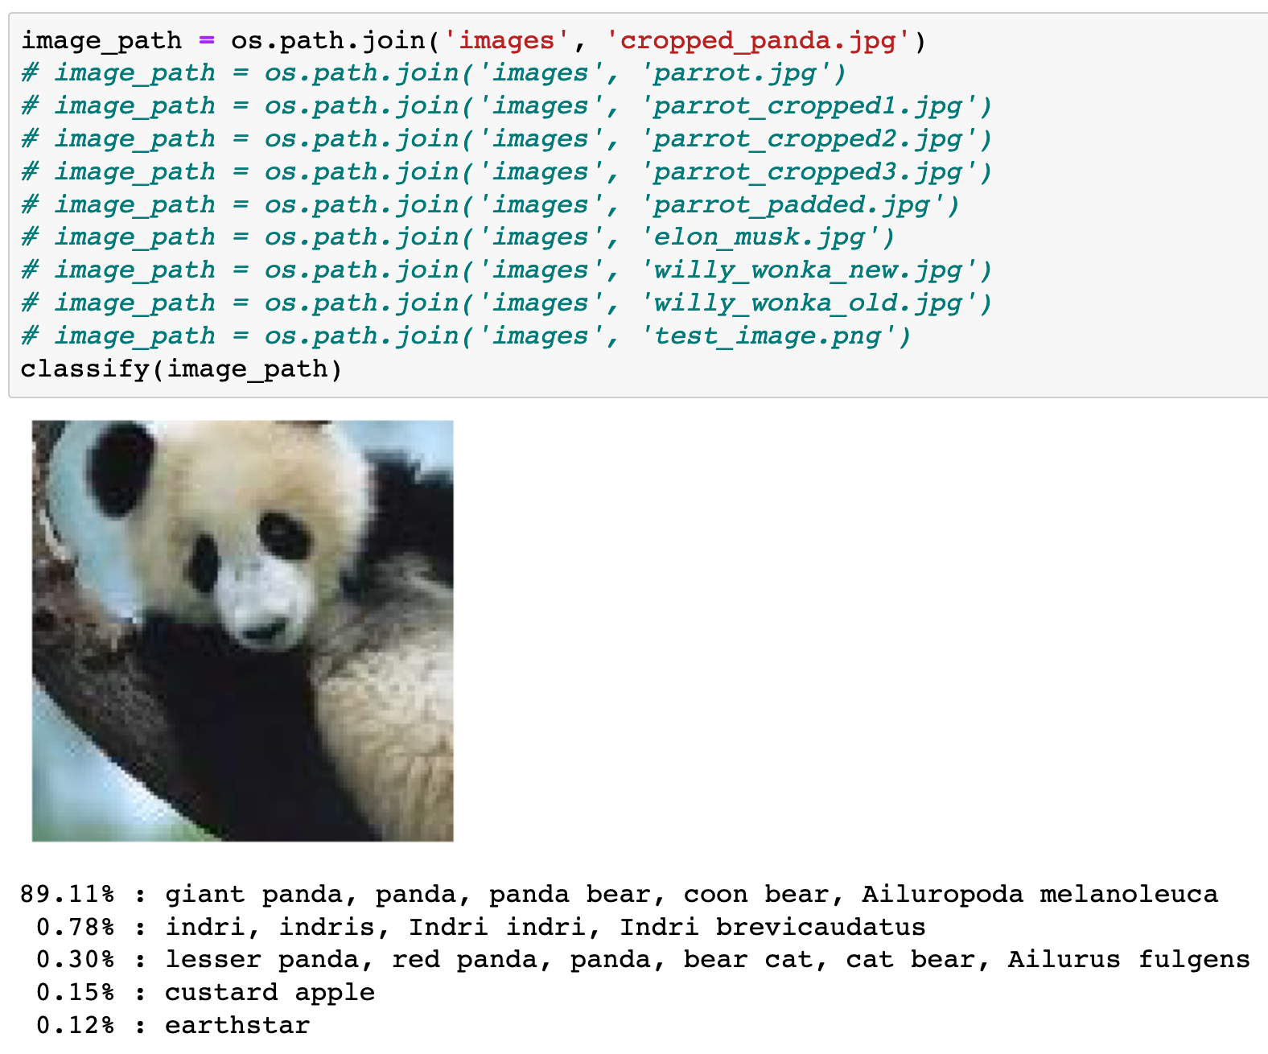

Slide 42
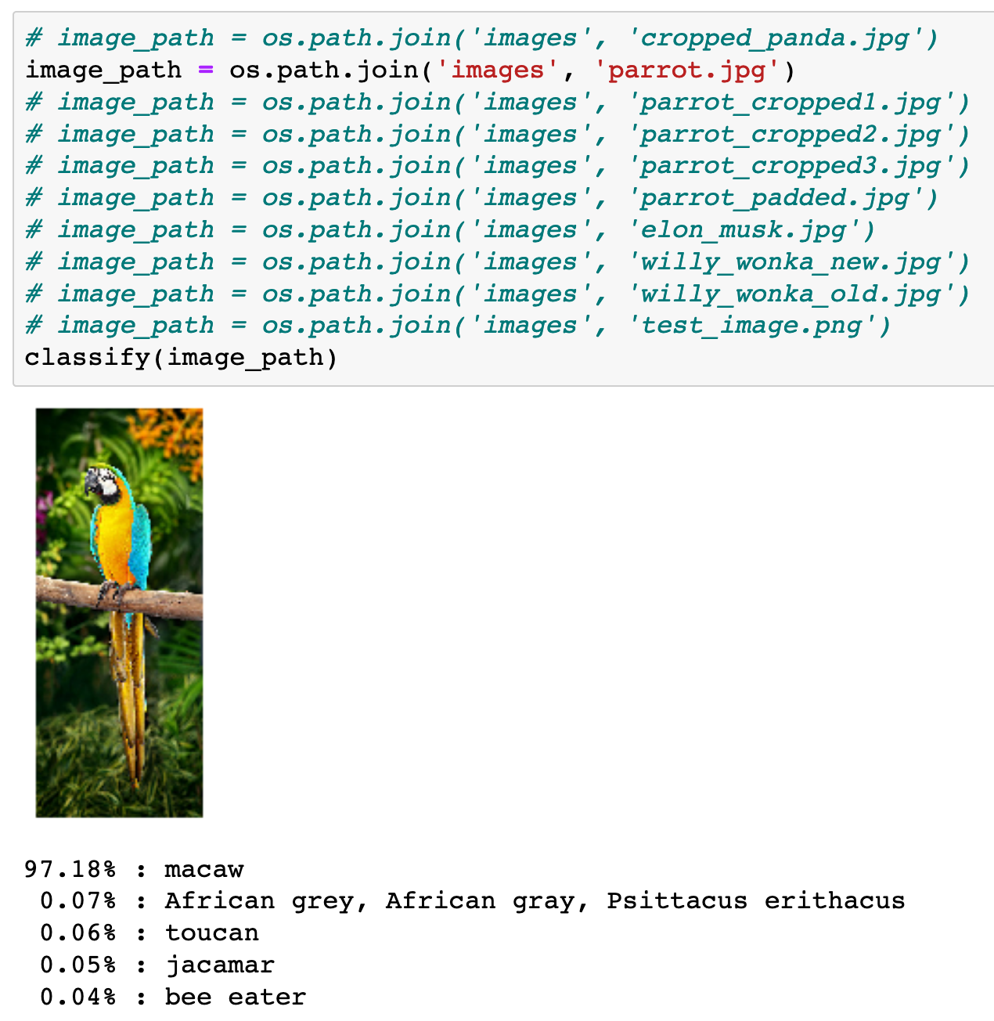

Slide 43
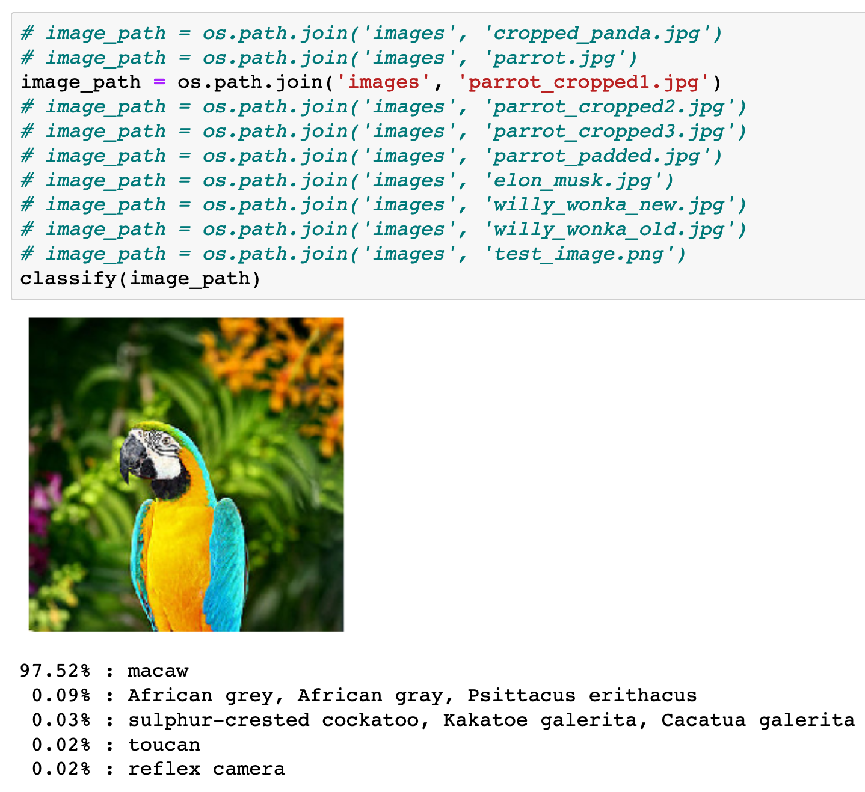

Slide 44
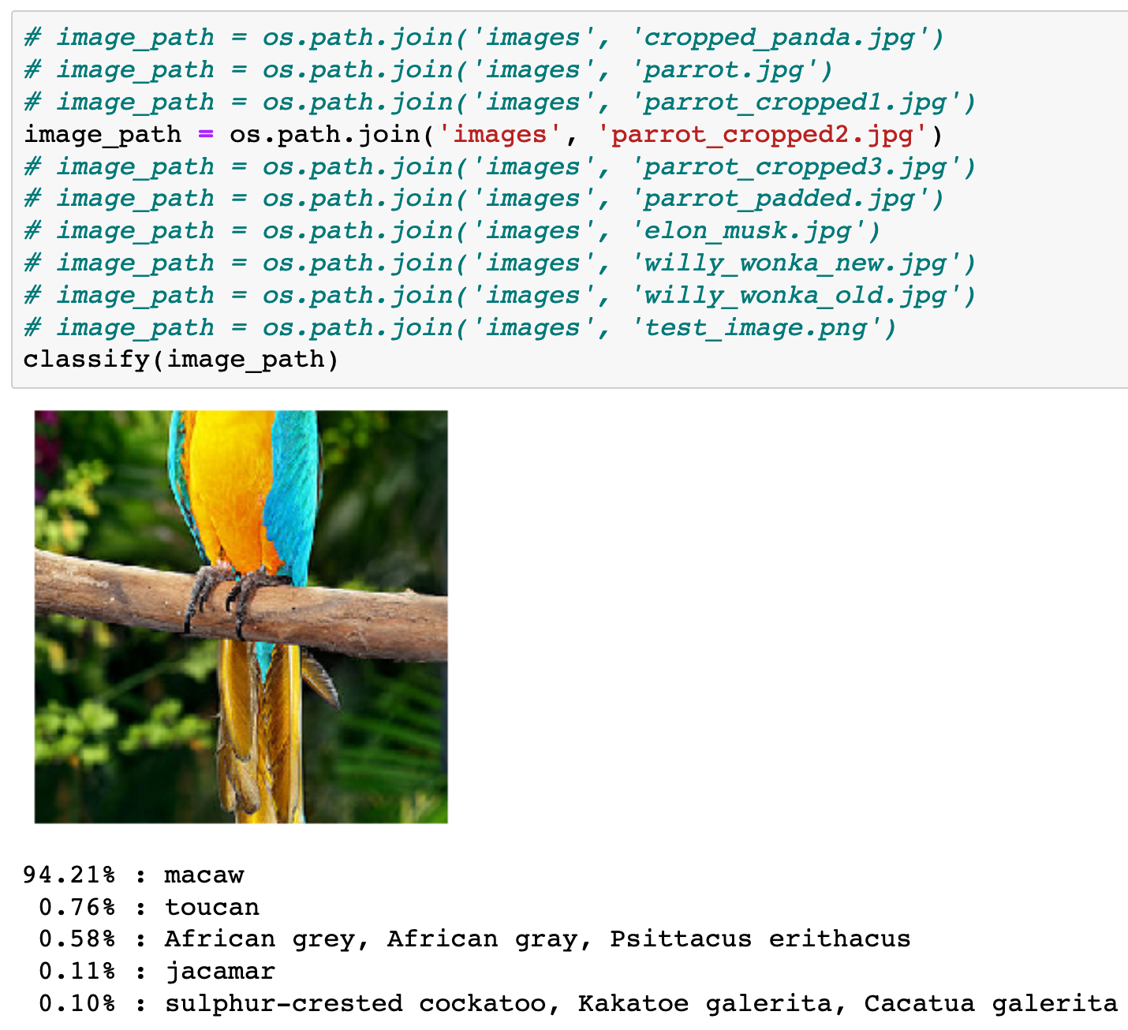

Slide 45
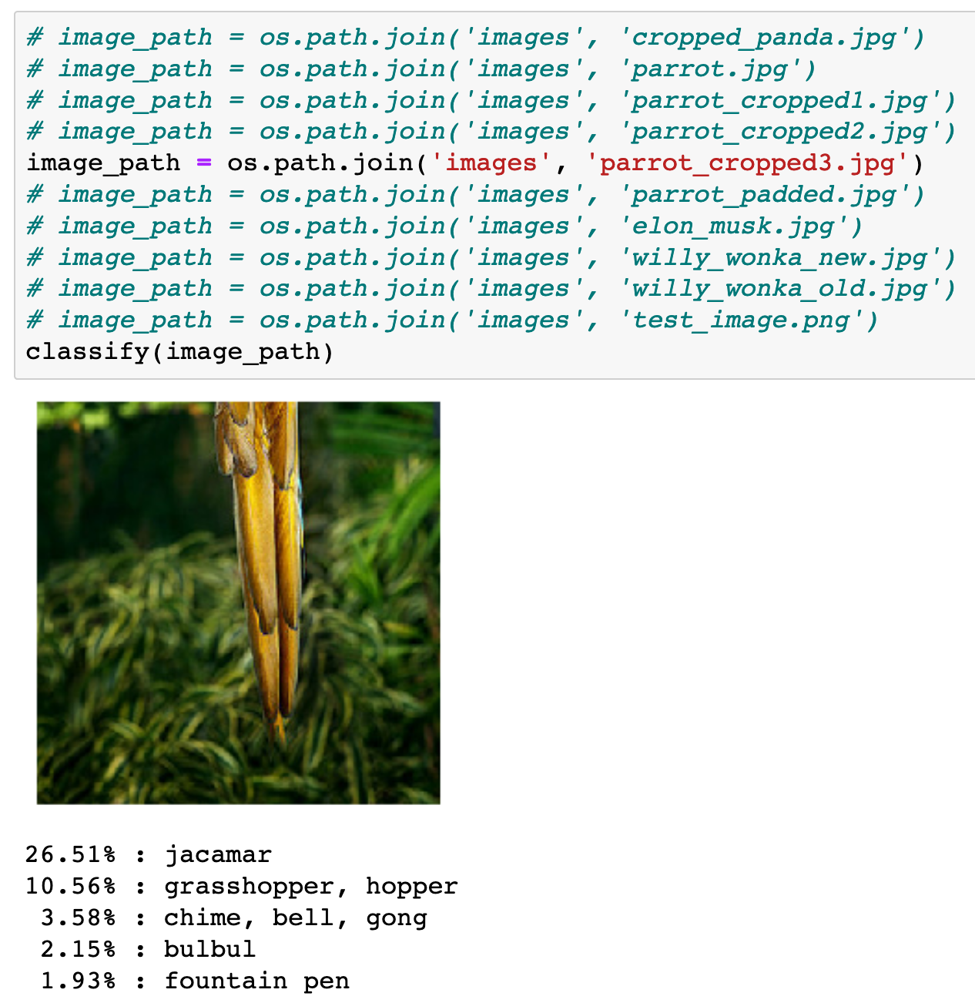

Slide 46
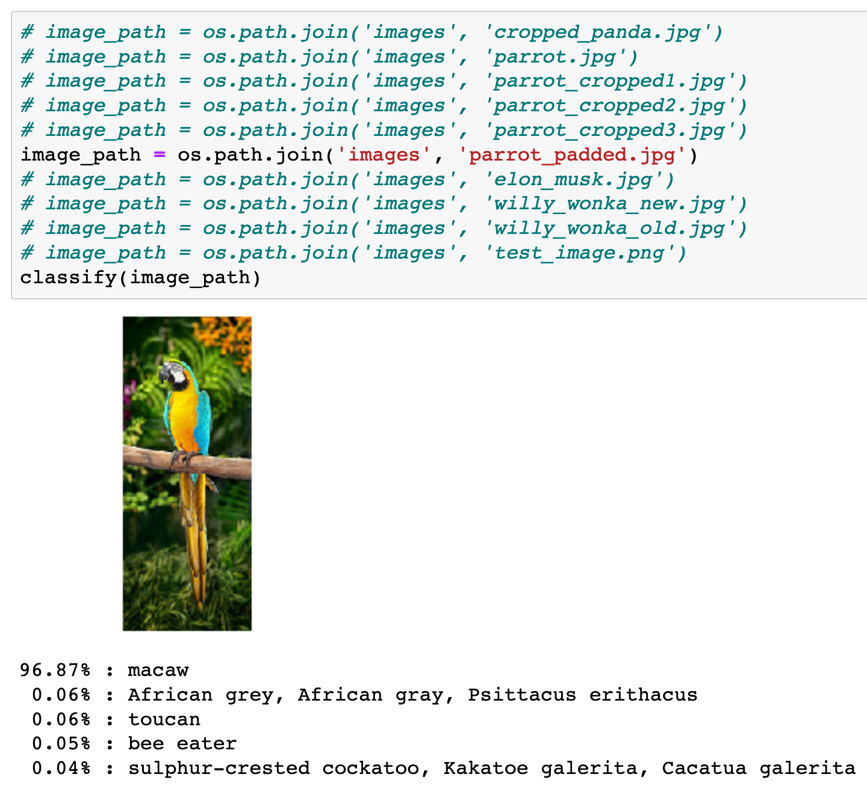

Slide 47
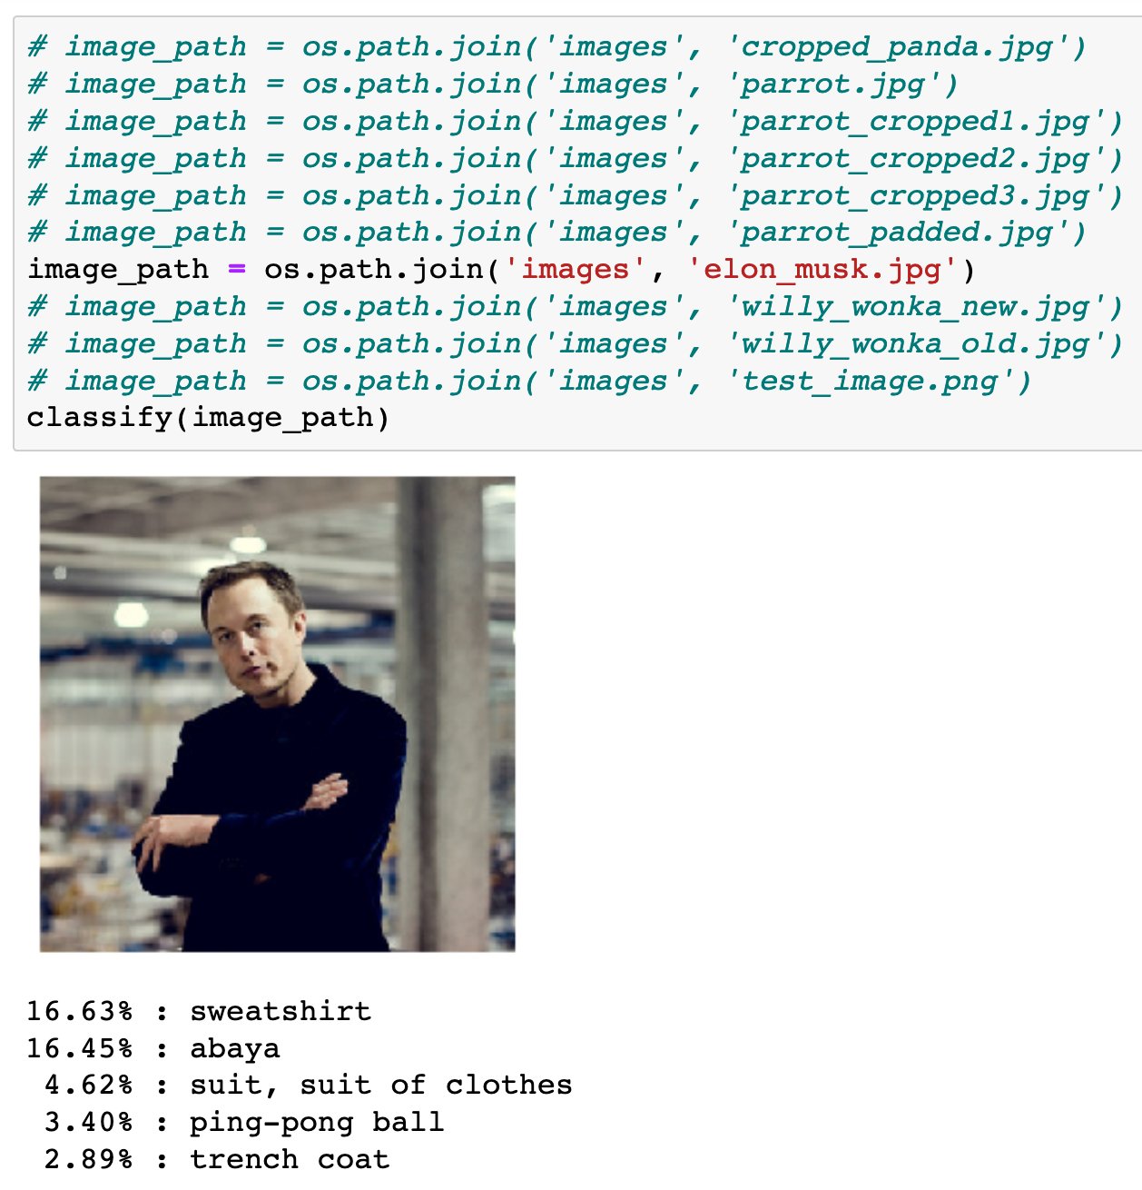

Slide 48
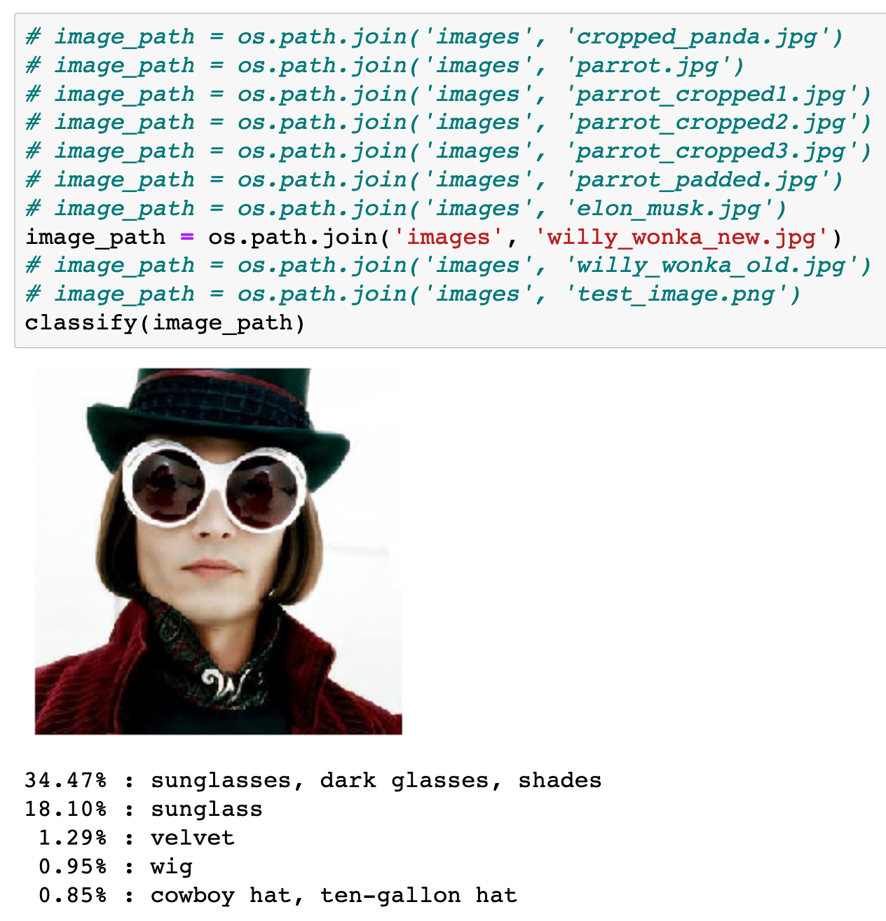

Slide 49
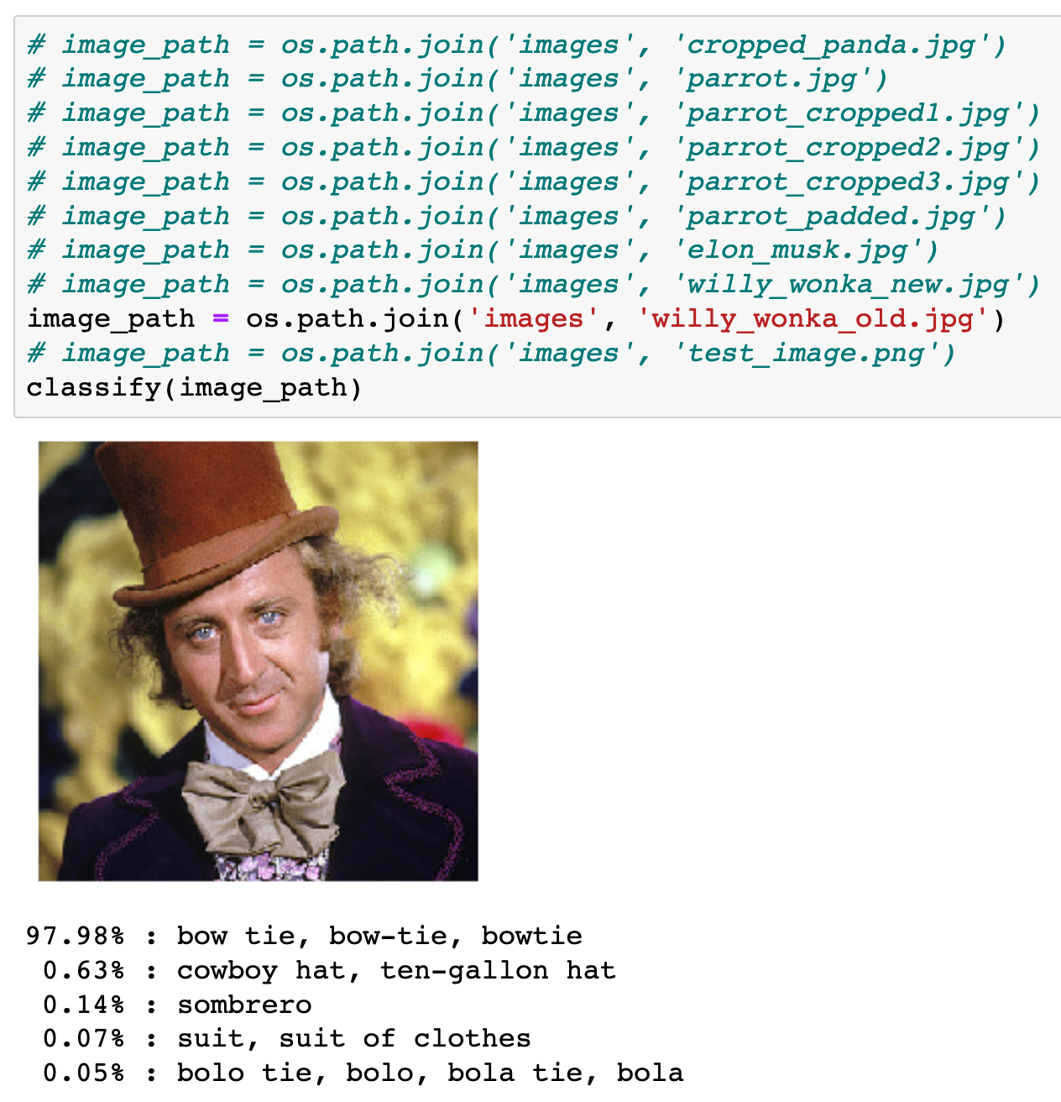

Slide 50
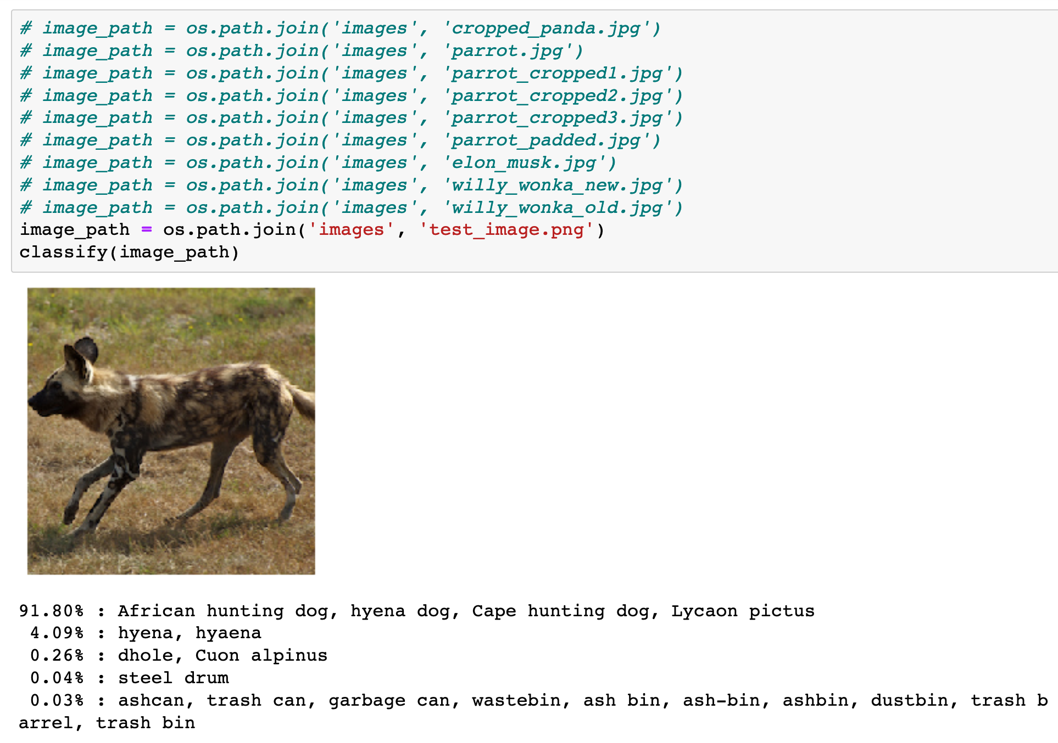

Slide 51
What happens if img size
is not
(299, 299, 3)

Slide 52
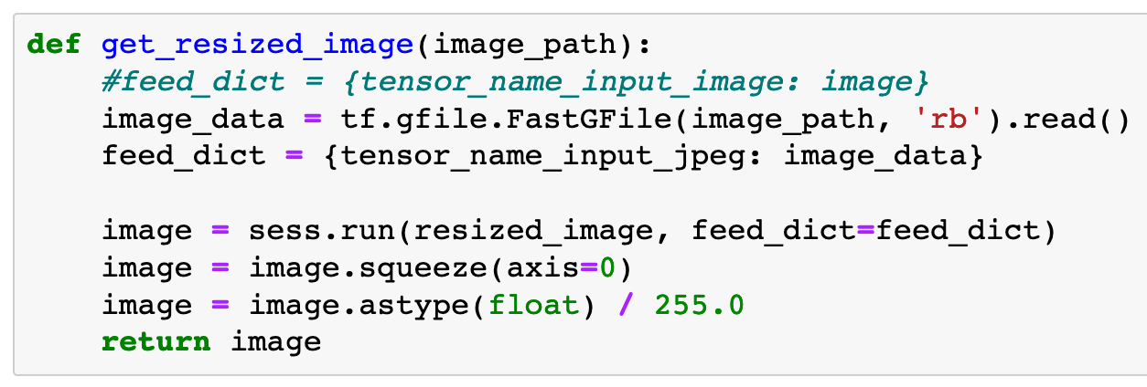

Slide 53
placeholder for image

Slide 54
placeholder for image
image to feed

Slide 55
image from 0 to 255
placeholder for image
image to feed

Slide 56
image from 0 to 255
image from 0 to 1
placeholder for image
image to feed

Slide 57
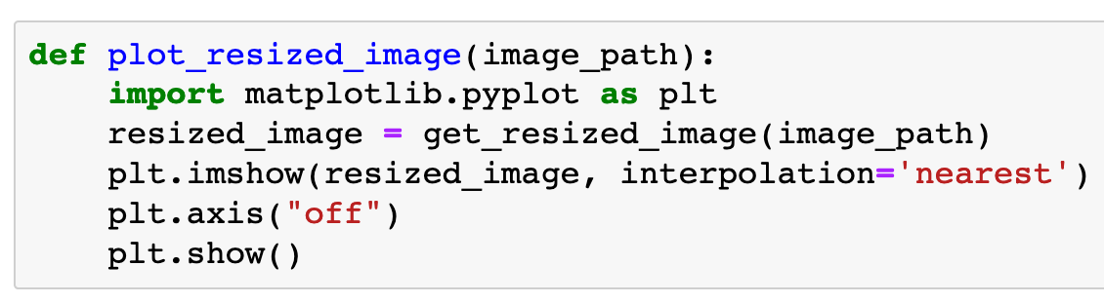

Slide 58
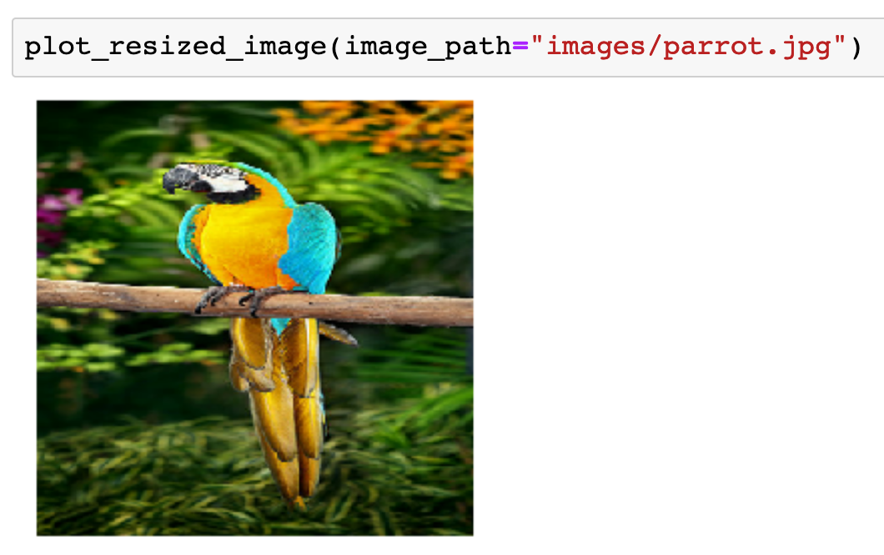

Slide 59
Now
Let’s Play with Code

